Slide 1
ANNUAL WORTH COMPARISON

Slide 2
Why Annual Worth Comparison?
Many economic decision are assisted by determining the costs, expenditures, and net worth on the basis of annual or periodic timings.
Manufacturing manager is often required to justify the operations on , monthly or annual basis.
Annual goals are frequently set.

Slide 3
Procedure
In this method all the receipts and disbursements occurring over a period are converted to an equivalent uniform yearly amount.

Slide 4
Advantages
It is possible to view an years gains and losses as a milestone for progress.
Cost accounting procedures, depreciation expenses, tax calculations and other summary reports are annual.
The major tool used in annual worth calculations is the capital recovery factor that converts a lumpsum into annuity.

Slide 5
EXAMPLE 1
A food beverage company is planning expansion of its cold storage facility. Three alternative site design proposals are being considered that uses an interest rate of 10%. Plan A and B require an expenditure of Rs.35,00,000 for land and which will retain its value in 10 years, while plan C requires Rs.45,00,000 for land, which will also retain its value in 10 years. The estimated income increase due to facility available is annualized at Rs.24,80,000 per year. the company requires that a life of 10 years be used for analysis. Data pertaining to the project are given below,

Slide 6
In Rs. | Proposal A | Proposal B | Proposal C
Building and installation | 60,00,000 | 70,00,000 | 40,00,000
Compressor | 10,00,000 | 13,50,000 | 8,50,000
Expected energy cost 1 year | 6,50,000 | 4,80,000 | 6,50,000
Energy cost increase for each additional year | 30,000 | 20,000 | 35,000
Annual maintenance cost | 2,00,000 | 1,50,000 | 5,00,000
Estimated salvage value | 3,50,000 | 4,30,000 | 1,80,000
Proposal A: -168673.3
Proposal B: -126114.2
Proposal C: -310808.6

Slide 7
Cash Flow Diagram
3,50,000
A (Income)= 24,80,000
0
1
10
A= 2,00,000
35,00,000
6,50,000
60,00,000
G= 30,000
10,00,000

Slide 8
Situations for Equivalent Annual Worth Comparison
Negative cash flows that is costs or disbursements are more than receipts. But alternative should be selected.
Ex- safety measures

Slide 9
Consolidation of cash flows
A consulting firm proposes to provide “self inspection” training for clerks who work with insurance claims. The program lasts one year, costs Rs. 20,000 per month, and professes to improve quality while reducing clerical time. A potential user of the program estimates that savings in the first month should amount to Rs. 8000 and should increase by Rs. 4000 per month for the rest of the year. however . Operational confusion and work interference are expected to boost clerical costs by Rs.12,000 the first month but this amount should subsequently decline in equal increments at the rate of Rs.1000 per month. If the required rate of return on money is 12% compounded monthly and there is a stipulation that the program must pay for itself within 1 year, should the consultant be hired. [Ans- 2907.25]

Slide 10
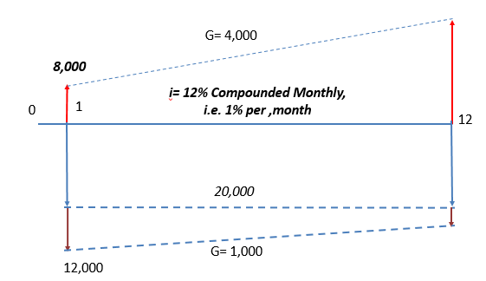

Slide 11
Case A:
Two machines models A and B perform the same function. Type A machine has a low initial cost of Rs. 95000, relatively high operating cost of Rs.19,000 per year more than those of type B machine, and a short life of 4 years. Type B machine costs Rs. 2,51,000 and can be used for 8 years. The scrap value from either machine at the end of the life will barely cover its removal cost. Which is preferred when the minimum attractive rate of return is 8%? [47680;43680]
Case B:
If machine A will produce refinements within 4 years with the availability of a modified one at a cost of Rs. 1,15,000 but reducing the operating costs to Rs.4000, then find the annual worth? [43890]
Note: if the future conditions can be estimated in confidence, excluding inflation then alternative has to be compared considering these.

Slide 12
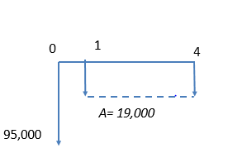
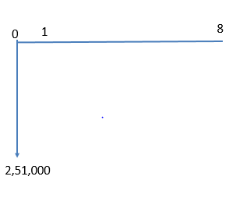
Case A
Type B
Type A

Slide 13
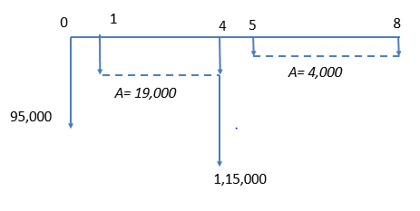
Case B
Type B
Type A

Slide 14
Capital Recovery Method
F
0
@i%
n
P
Let, P= first cost of the asset, F= estimated salvage value,
n= estimated service life in years, CR(i)= capital recovery with return.
CR(i)= P(A/P, i, n) – F(A/F, i, n)
But since, (A/F, i, n)=(A/P, i, n) – i
CR(i)= P(A/P, i, n) – F[(A/P, i, n) – i]
CR(i)= (P-F) (A/P, i, n) + F.i

